Slide 1
ASSEMBLY LANGUAGE AND COMPUTER ARCHITECTURE LAB
PROJECT : Calculate the area under the curve using numerical integration
Group 9: - Nguyen Tuan Dung
- Trinh Thanh Minh
- Le Ngoc Kien
- Phi Quoc Hung

Slide 2
Presentation outline
1. Floating-point arithmetic on MIPS Computer
2. Numerical integration methods
3. Assembly program with description
4. Program demo
5. Program report

Slide 3
1. Floating-point arithmetic on MIPS
The reason for floating-point representation
A number in scientific notation that has no leading 0s is called a normalized number
A standard scientific notation for reals in normalized form offers three advantages.
- Simplifies the exchange of data that includes floating-point numbers.
- Simplifies the floating-point arithmetic algorithms to know that numbers will always be in this form.
- Increases the accuracy of the numbers that can be stored in a word since the unnecessary leading 0s are replaced by real digits to the right of the binary point.

Slide 4
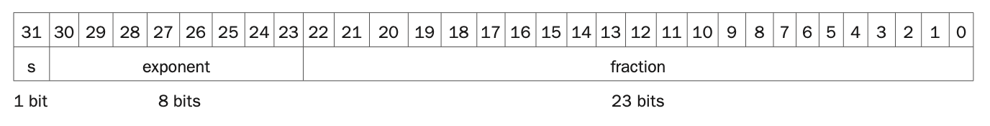

1. Floating-point arithmetic on MIPS
How MIPS represents floating-point numbers.
The floating-point numbers are represented in IEEE 754 standard, and the general structure of the number is:
s stands for the sign bit with a length of 1 (1 meaning negative),
e stands for the exponent field with 8-bit length,
f stands for fraction field, we can simply understand it as the fractional part in float decimal number with 23-bit length.
In general, floating-point numbers are of the form of single-precision:

Slide 5
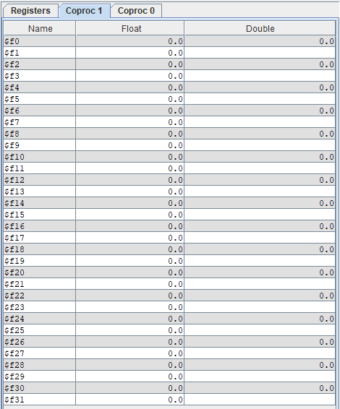
1. Floating-point arithmetic on MIPS
MIPS instructions for floating-point numbers.
• abs.s $f0, $f1 • add.s $f0, $f1, $f2 • sub.s $f0, $f1, $f2 • mul.s $f0, $f1, $f2 • div.s $f0, $f1, $f2 • neg.s $f0, $f1 | • mfc1 $t0, $f0 • mtc1 $t0, $f0 • lwc1 $f0, 0($t0) • swc1 $f0, 0($t0) • mov.s $f0, $f1 | • cvt.s.w $f0, $f1 • cvt.w.s $f0, $f1 • c.lt.s $f0,$f1 • bc1t L1 • bc1f L1
In MIPS, the coprocessor 1 has 32 floating point registers ($f0 -> $f32). Among these registers, only 16 even number registers are used for double-precision operations ($f0, $f2, …$f30)

Slide 6
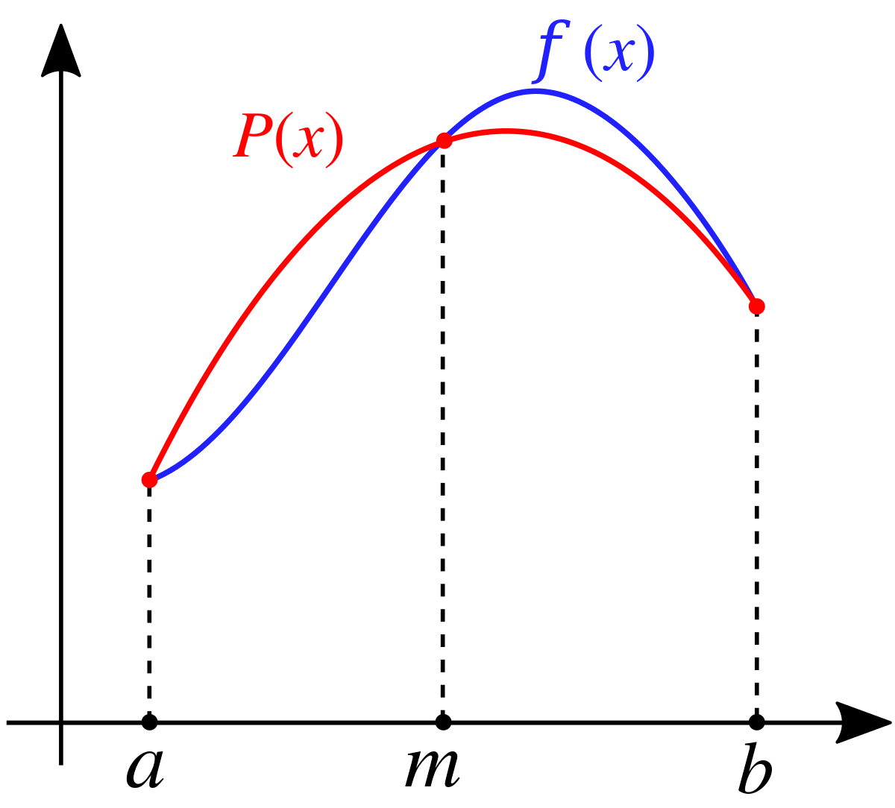
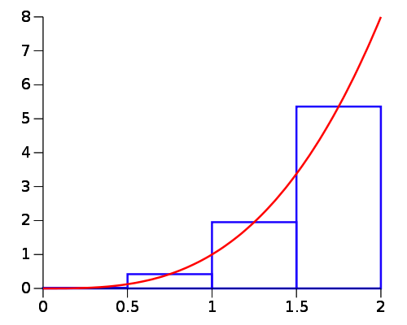
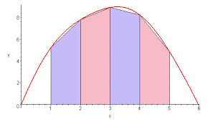
2. Numerical Integration methods
Rectangle Method
Trapezoid Method
Simpson’s Method

Slide 7
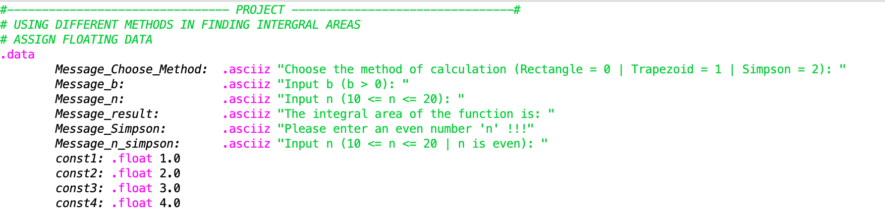
3. Assembly program description
Initialize some data for display and interacting with user

Slide 8
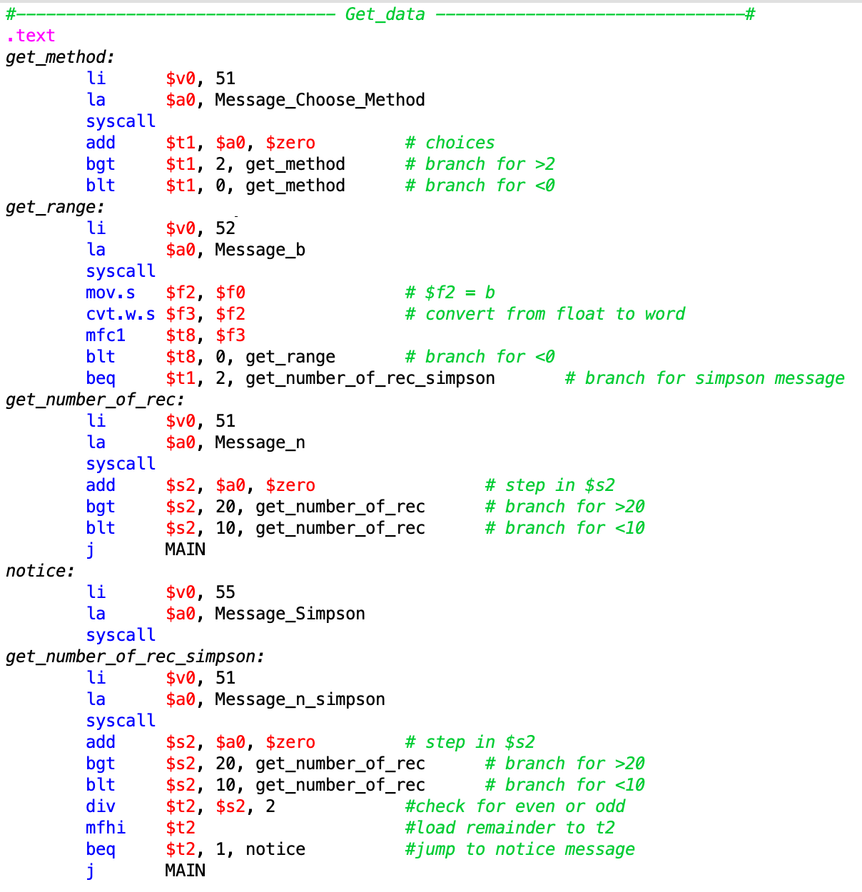
3. Assembly program description
Get data from keyboard input
There are 3 choices in the method choosing, denote by number 0, 1, 2.
If we try to choose a number outside the range, we will have to choose again

Slide 9
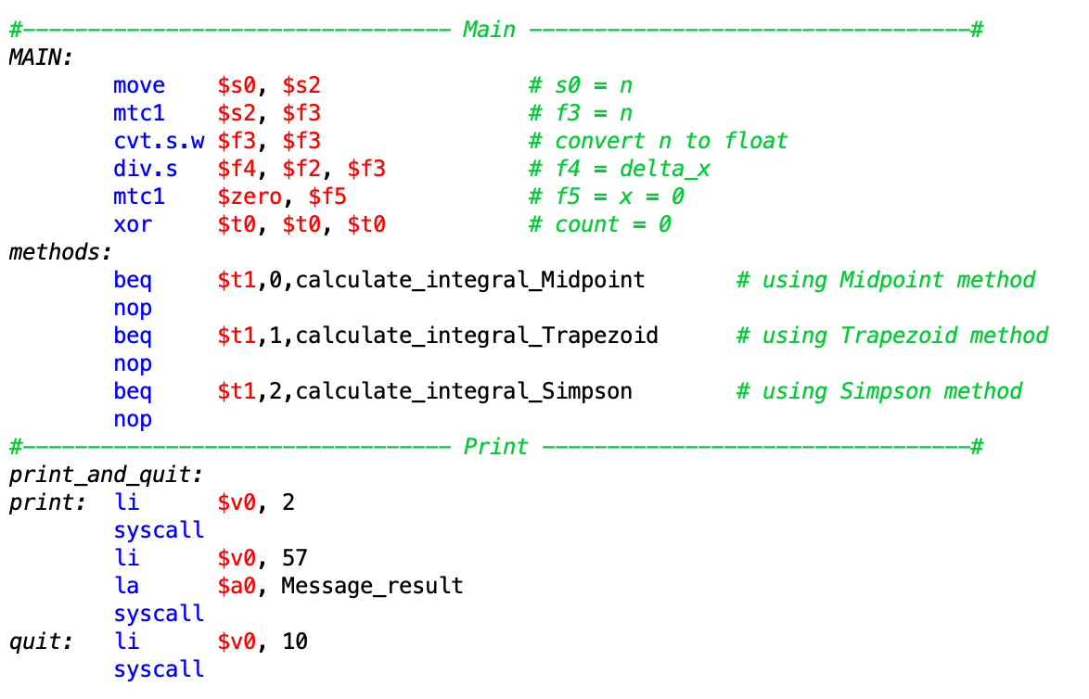
3. Assembly program description
Main:
Store input data into registers for later calculation.
Jump to the method of user choice.
Print:
Print out the message and the corresponding floating-point result stored in $f12.
Terminate the program.

Slide 10
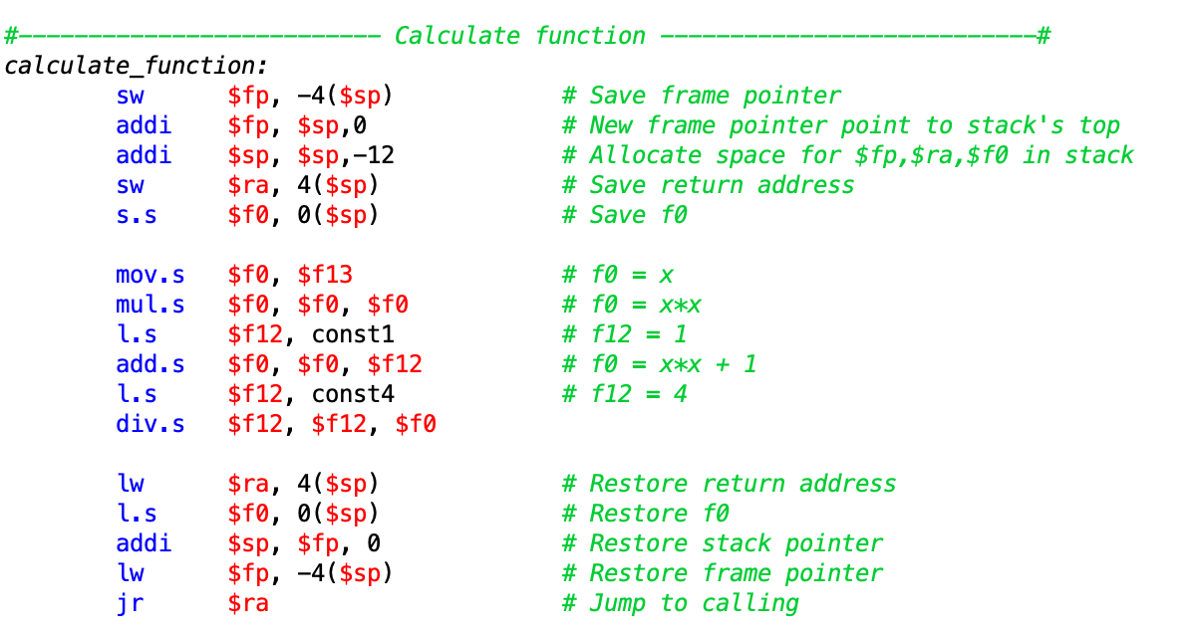
3. Assembly program description
We create a calculate function to for f(x) = 4/(x^2 + 1)
This function is use for all of our method.
It receives a float at $f12 as variable x, does calculation, and then returns the value of f(x) to $f0.

Slide 11
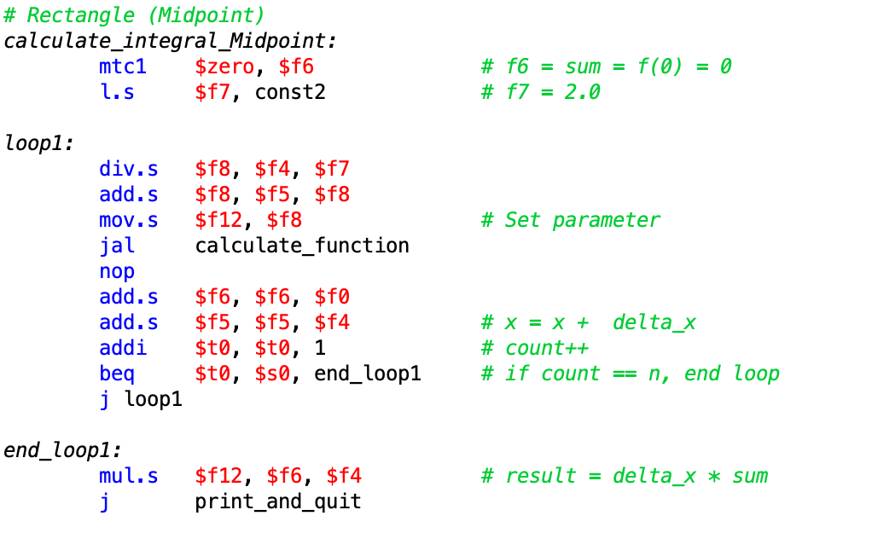
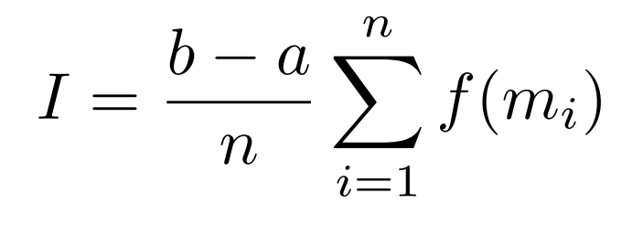
3. Assembly program description
Rectangle Method

Slide 12
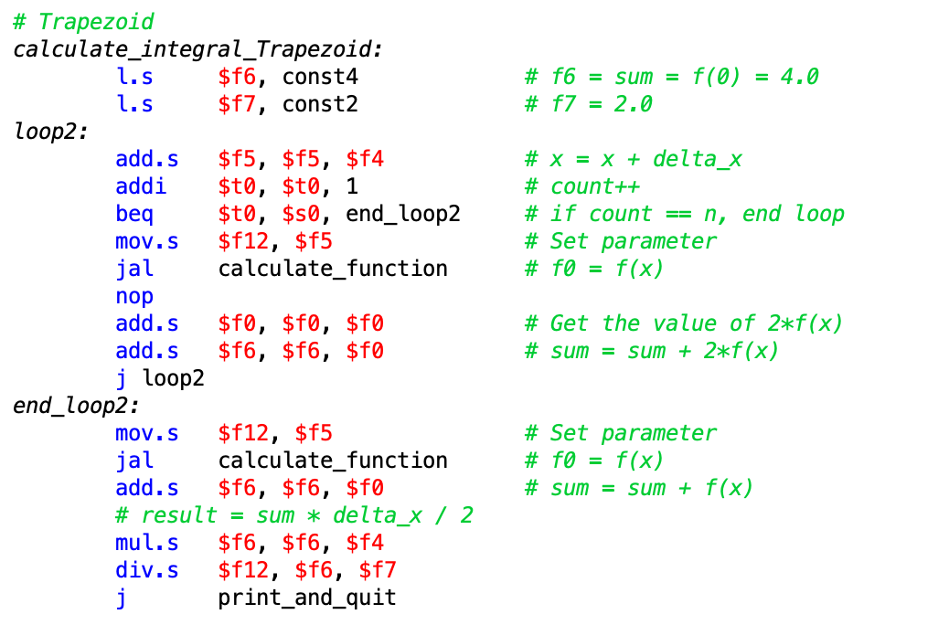

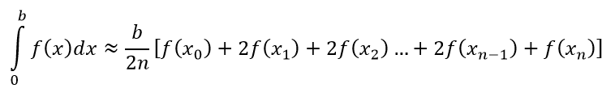
3. Assembly program description
Trapeziod Method
The area of each little intervals is:

Slide 13
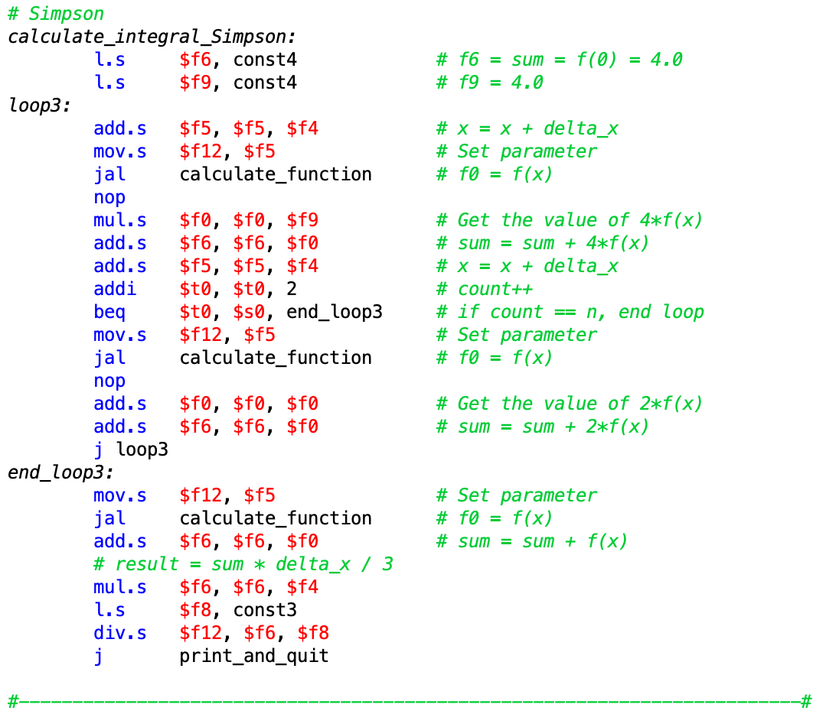
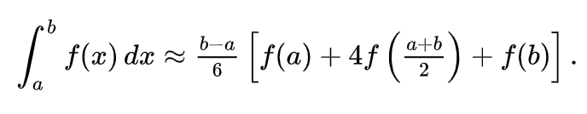
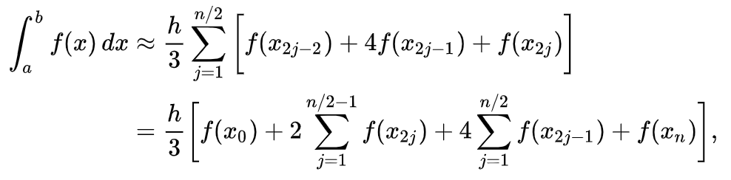
3. Assembly program description
Simpson’s Method

Slide 14
4. Assembly program description

Slide 15
5. Program report
stt | b | n | REC | TRAP | SIMP | Definite Integral
1 | 2 | 10 | 4,42966 | 4,426463 | 4,4285865 | 4,428594
2 | 2 | 15 | 4,4290686 | 4,427648 | NULL
3 | 2 | 20 | 4,428861 | 4,428062 | 4,4285946
4 | 2,5 | 10 | 4,7621484 | 4,7591805 | 4,7611356 | 4,761159
5 | 2,5 | 15 | 4,7616005 | 4,7602797 | NULL
6 | 2,5 | 20 | 4,7614074 | 4,760665 | 4,7611594
7 | 3 | 10 | 4,997081 | 4,994386 | 4,996054 | 4,996183
8 | 3 | 15 | 4,9965825 | 4,9953823 | NULL
9 | 3 | 20 | 4,9964075 | 4,9957337 | 4,996183
10 | 3,5 | 10 | 5,1707983 | 5,1683617 | 5,1694474 | 5,169986
11 | 3,5 | 15 | 5,170348 | 5,1692634 | NULL
12 | 3,5 | 20 | 5,17019 | 5,169579 | 5,1699862
13 | 4 | 10 | 5,3040047 | 5,3017993 | 5,301637 | 5,303271
14 | 4 | 15 | 5,3035984 | 5,302615 | NULL
15 | 4 | 20 | 5,303455 | 5,3029003 | 5,303269
Table 1: The result observed when implementing 3 methods of integral calculation with pairs of number (b, n)

Slide 16
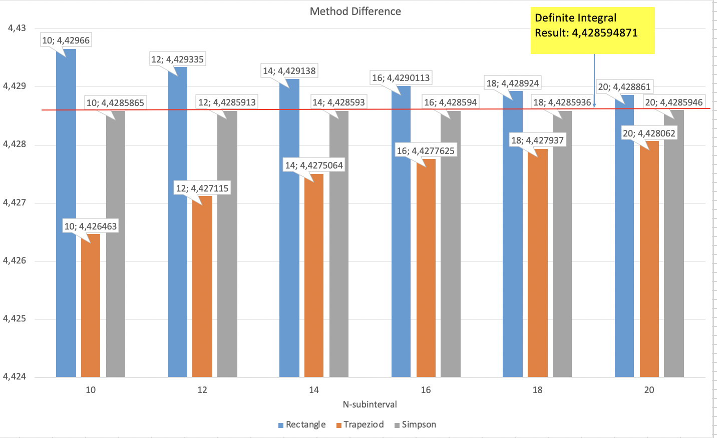
5. Program report
Chart 1: Difference of the result computed with 3 methods

Slide 17

Thank you for listening and have a nice day!

